Slide 1
STAT467 Multivariate Analysis
Ali Aytuğ Tok
2502409
Selim Çağrı Baygın
2501997
Elif Sıla Öztürk
2421170

Slide 2
Outline
Data Description
Exploratory Data Analysis
Main Research Questions and Analysis
Conclusion

Slide 3
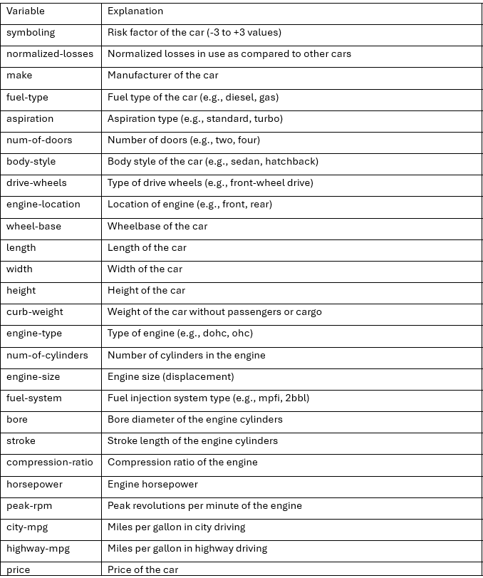
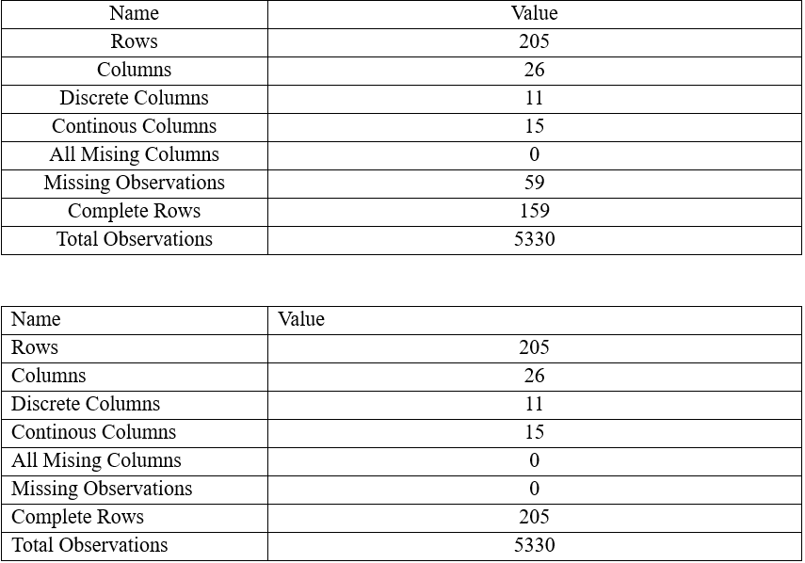
Data Description

Slide 4
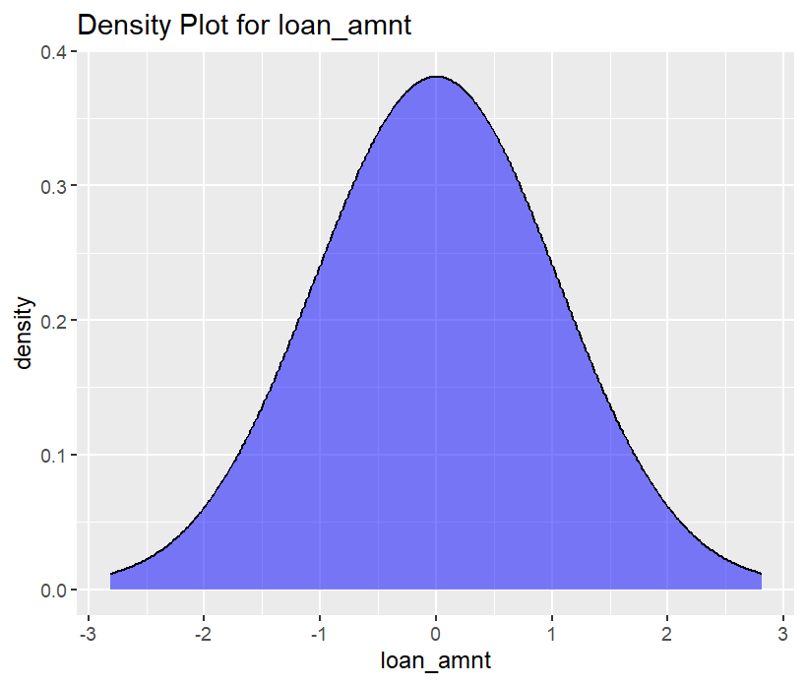
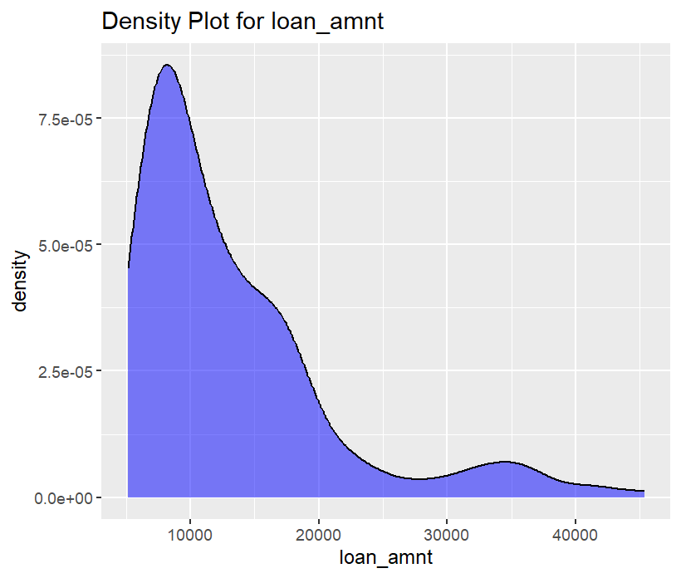
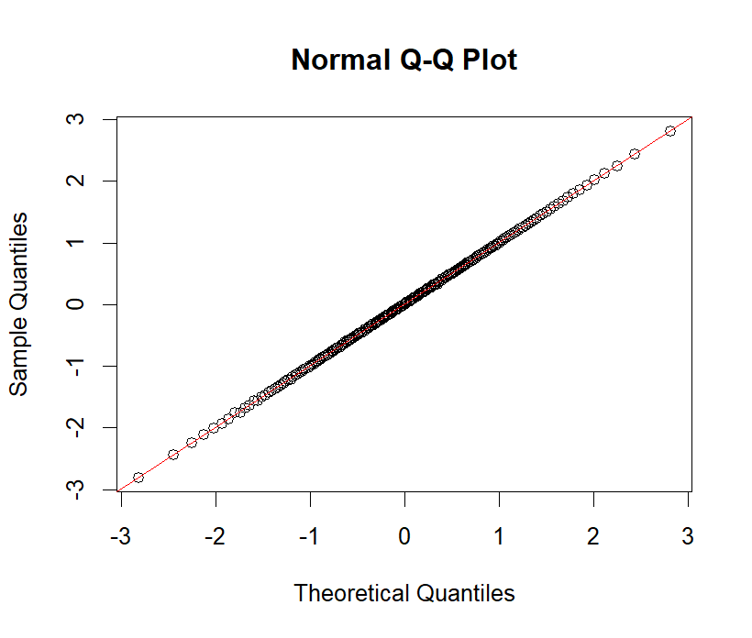
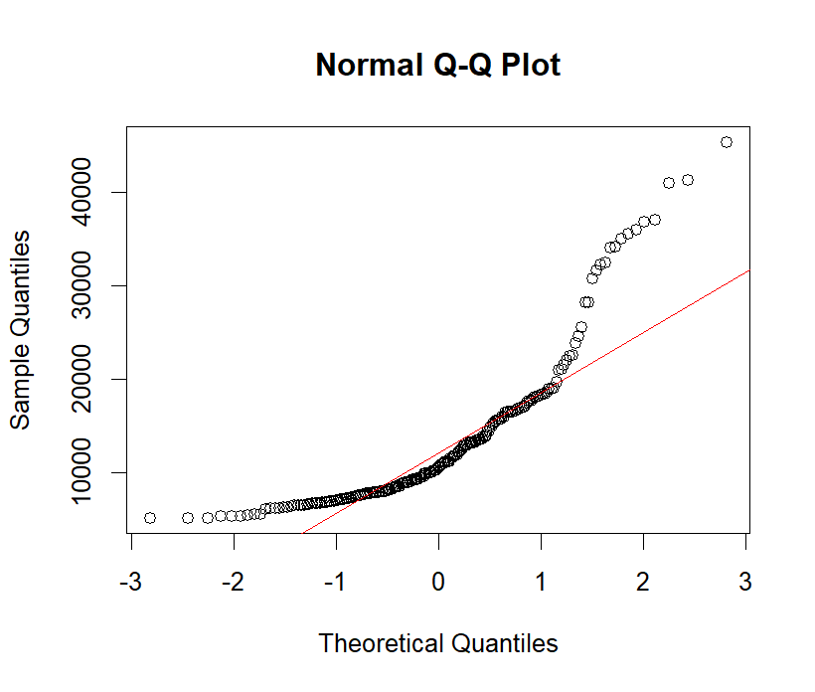
Normality of Responses
Price

Slide 5
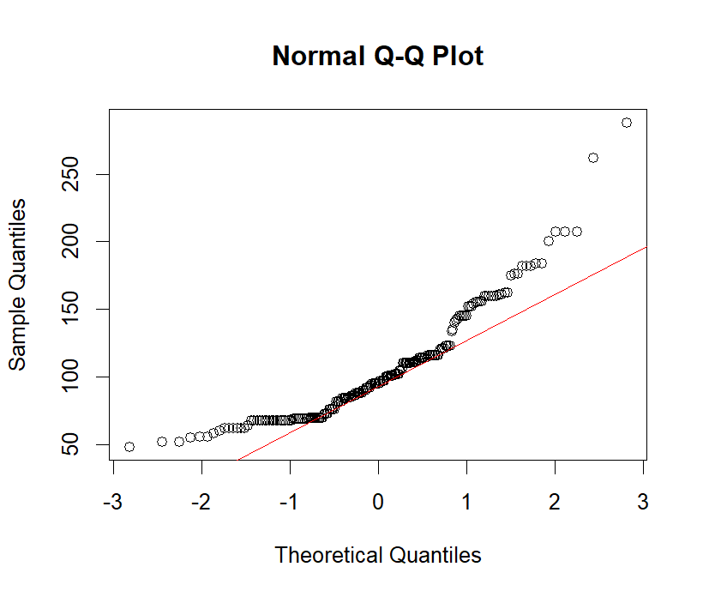
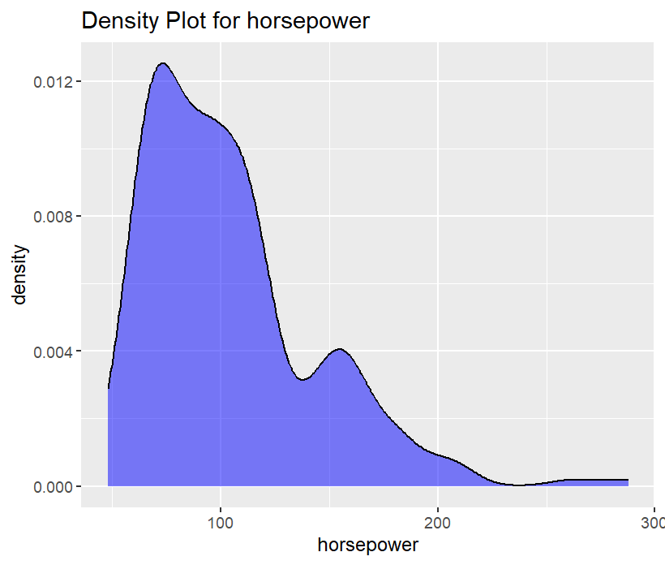

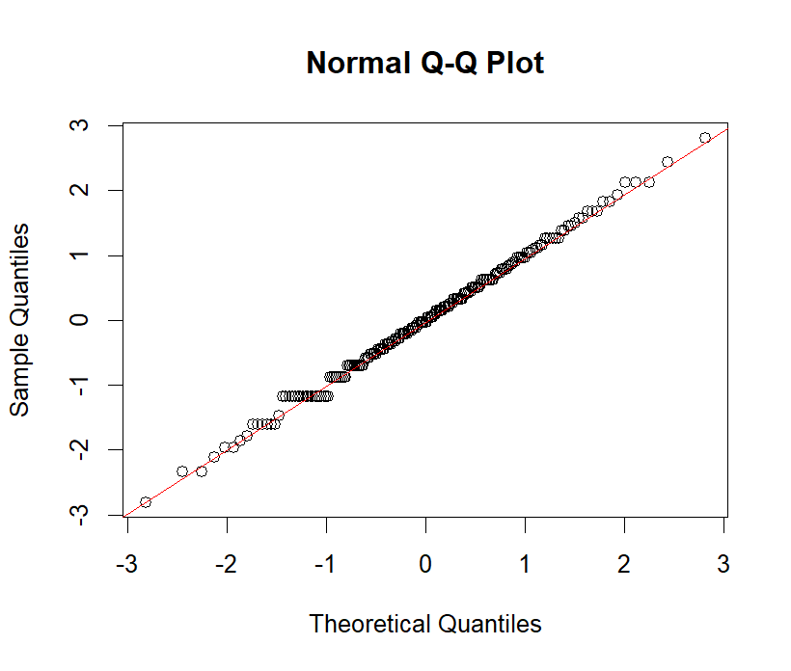
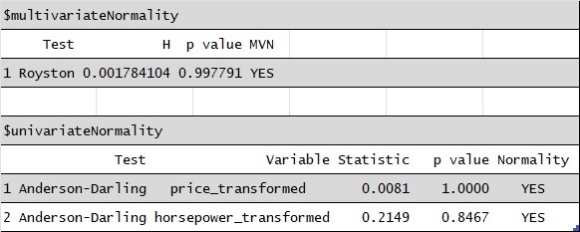
Normality of Responses
Horse-Power

Slide 6
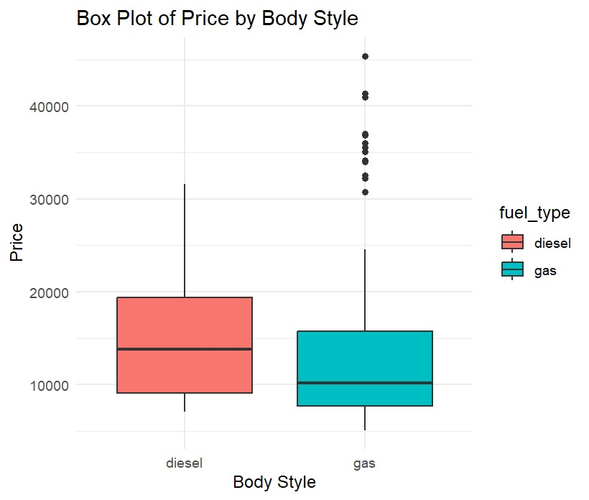
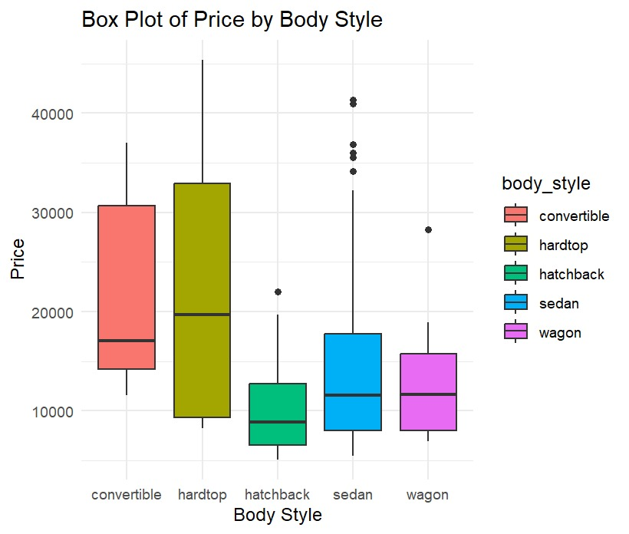
Box-Plots

Slide 7
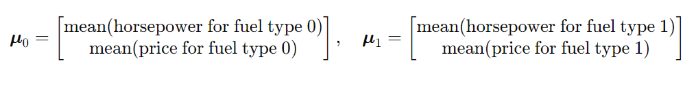
Inferences About a Mean Vector
Does fuel type (diesel or gasoline) significantly influence the mean differences in vehicle price and horsepower?
Null Hypothesis (H0): The mean vectors of the dependent variables horsepowerand price are the same for both fuel type groups (diesel or gas)
H0: μ0 = μ1
Alternative Hypothesis (H1): The mean vectors of the dependent variables horsepower and price differ between the two fuel type groups
HA: μ0 ≠ μ1

Slide 8
T^2 | Df1 | Df2 | P-value
10.053 | 2 | 202 | 0.000068850
Simultaneous Confidence Intervals
Variable | Lower | Upper
Horsepower | -0.4745961 | 0.6384037
Price | -1.037029 | 0.1259167
Bonferroni Confidence Intervals
Variable | Lower | Upper
Horsepower | -0.4264321 | 0.5902396
Price | -0.9867032 | 0.07559132

Slide 9
Comparisons of Several Multivariate Means
Does the multivariate model of automobile parameters, including price and horsepower, reveal a significant effect of body style?
Null Hypothesis (H0): The mean vectors of the dependent variables price and horsepower are the same across all levels of the body style.
H0: μ1 = μ2 = ... = μ5
Alternative Hypothesis (H1): At least one mean vector of the dependent variables differs across the levels of the independent variable.
HA: At least one μi ≠ μj for i ≠ j
Effect | Df | Pillai | Pr(>F)
body_style_dummy | 4 | 0.067902 | 0.0008234***
Residuals | 201

Slide 10
Post-Hoc Analysis
response price | Df | Sum of Suq | Mean of SS | F-value | Pr(>F)
body_style_dummy | 4 | 9.272 | 2.318 | 2.42 | 0.002131
Residuals | 201 | 194.434 | 0.9578
response horsepower | Df | Sum of Suq | Mean of SS | F-value | Pr(>F)
body_style_dummy | 4 | 1.432 | 143.159 | 1,45 | 0.2304
Residuals | 201 | 200.794 | 0.98913

Slide 11
Multivariate Multiple Regression Analysis
In this chapter, it is investigated that which factors has a significant effect on price and how the predictors predict both price and horsepower.

Slide 12
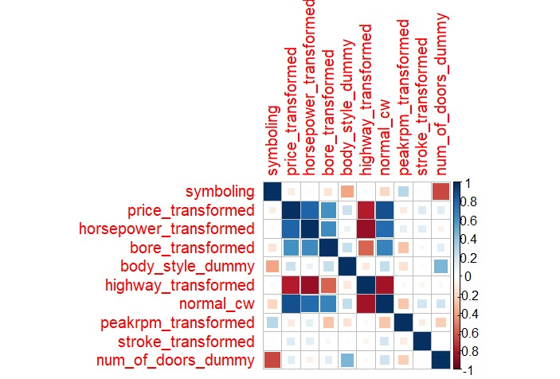
Correlation matrix for selected variables.

Slide 13
Summary for the regression model
Summary of the residuals:
Statistic | Value
Min | -2,1424
1Q | -0,3202
Median | -0,0468
3Q | 0,2668
Max | 1,7653

Slide 14
Summary for the Price
Coefficient summary
Term | Estimate | Std. Error | t value | Pr(>|t|)
(Intercept) | -0,22025 | 0,12975 | -1,698 | 0,09117
bore_transformed | 0,19485 | 0,05399 | 3,609 | 0,00039
body_style_dummy | 0,06001 | 0,05479 | 1,095 | 0,2747
highway_transformed | -0,67141 | 0,05057 | -13,278 | < 2e-16
symboling | 0,02497 | 0,04367 | 0,572 | 0,56813
peakrpm_transformed | -0,04711 | 0,04572 | -1,031 | 0,30401
stroke_transformed | 0,10563 | 0,04078 | 2,59 | 0,0103
num_of_doors_dummy | 0,16146 | 0,11119 | 1,452 | 0,14807

Slide 15
Summary for the Price
Regression summary:
Metric | Value
Residual standard error | 0,5665
Degrees of freedom | 197
Multiple R-squared | 0,6896
Adjusted R-squared | 0,6786
F-statistic | 62,53
F-statistic DF1 | 7
F-statistic DF2 | 197
p-value | < 2.2e-16

Slide 16
Summary for Horsepower
Variable | Estimate | Std. Error | t value | Pr(>|t|)
(Intercept) | 0,16125 | 0,10399 | 1,551 | 0,122608
bore_transformed | 0,30687 | 0,04354 | 7,048 | 2,98E-11
body_style_dummy | -0,01749 | 0,04391 | -0,398 | 0,6909
highway_transformed | -0,6674 | 0,04107 | -16,251 | 2E-16
symboling | -0,01995 | 0,035 | -0,57 | 0,569415
peakrpm_transformed | 0,17413 | 0,03683 | 4,728 | 4,31E-06
stroke_transformed | 0,12241 | 0,03267 | 3,747 | 0,000235
num_of_doors_dummy | -0,19702 | 0,08912 | -2,211 | 0,028207

Slide 17
Summary for Horsepower
Metric | Value
Residual standard error | 0,4541
Degrees of freedom | 197
Multiple R-squared | 0,7992
Adjusted R-squared | 0,792
F-statistic | 112
p-value | < 2.2e-16

Slide 18
VIF values for the components
Variable | VIF Value
bore_transformed | 1,815963
body_style_dummy | 1,335586
highway_transformed | 1,62531
symboling | 1,879852
peakrpm_transformed | 1,26981
stroke_transformed | 1,040964
num_of_doors_dummy | 1,940072

Slide 19
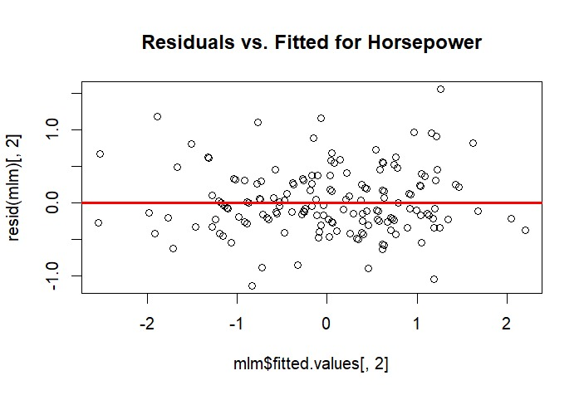
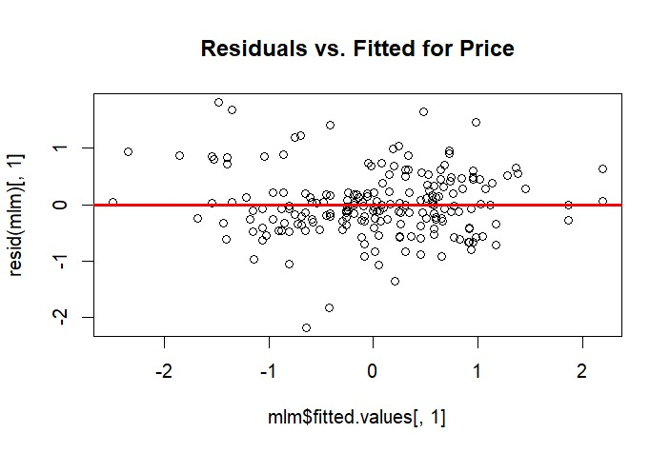
Assumption checks for regression analysis
Linearity:

Slide 20
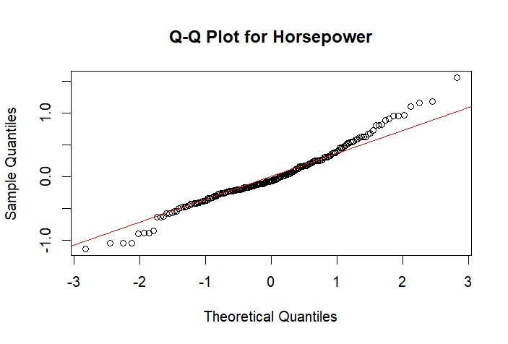
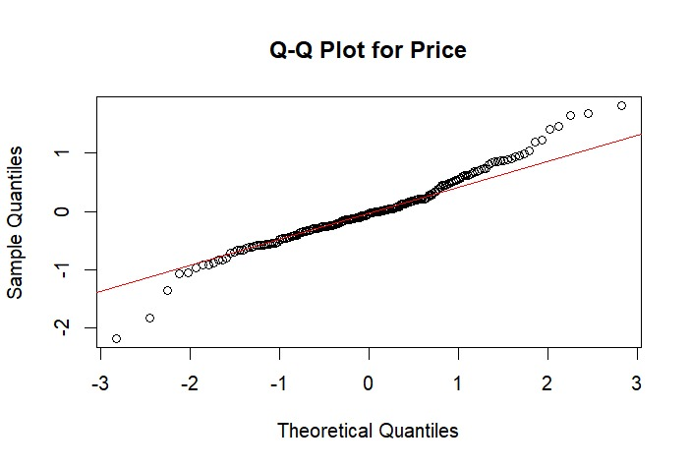
Assumption checks for regression analysis
Normality:

Slide 21
Assumption checks for regression analysis
Shapiro-Wilk test for normality:
Variable | W | p-value
Residuals of Price | 0,97152 | 0,000359
Residuals of Horsepower | 0,98125 | 0,007784
Indicates no normality for residuals.

Slide 22
Assumption checks for regression analysis
Breusch – Pagan test for checking homoscedasticity:
Model | BP Statistic | Degrees of Freedom (df) | p-value
Price ~ . | 17,267 | 7 | 0,01575
Horsepower ~ . | 22,036 | 7 | 0,002504
The test states that the model violates homoscedasticity property.

Slide 23
Normality status of the components
Variable | Statistic | p-value | Normality
symboling | 6,979 | <0.001 | NO
price_transformed | 0,0081 | 1 | YES
horsepower_transformed | 0,2149 | 0,8467 | YES
bore_transformed | 0,4497 | 0,2739 | YES
body_style_dummy | 13,5045 | <0.001 | NO
highway_transformed | 0,9413 | 0,0168 | NO
normal_cw | 1,0729 | 0,008 | NO
peakrpm_transformed | 1,5569 | 5e-04 | NO
stroke_transformed | 0,3111 | 0,5502 | YES
num_of_doors_dummy | 37,5167 | <0.001 | NO
Results are obtained according to the Anderson-Darling test.

Slide 24
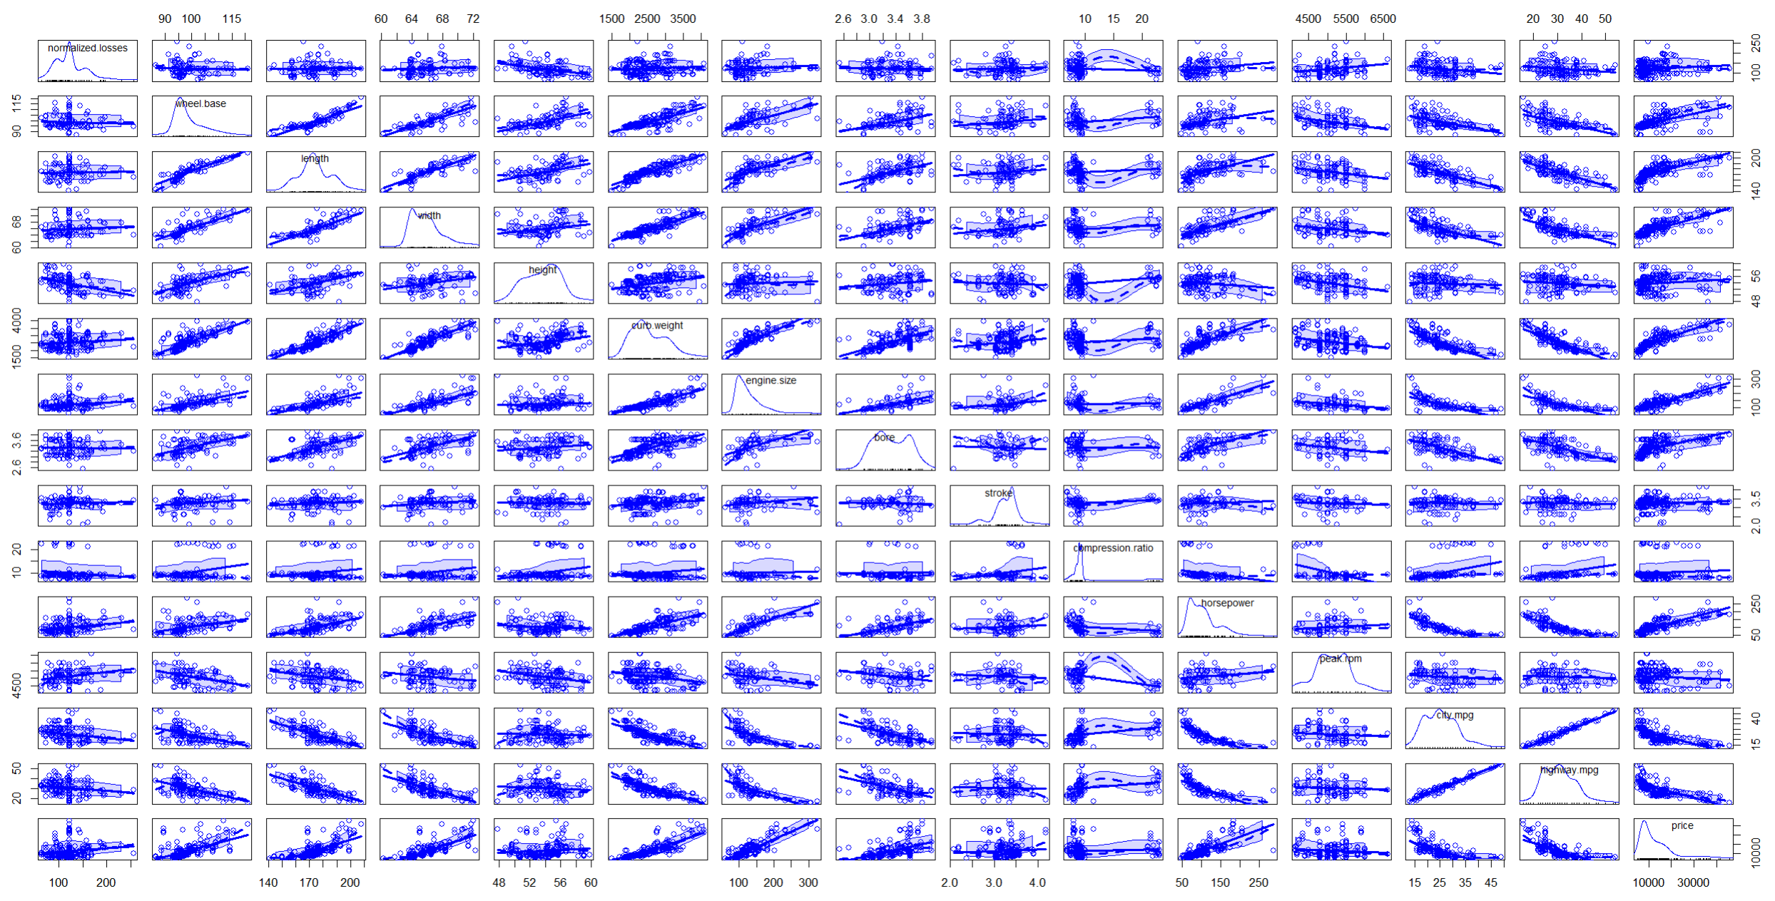
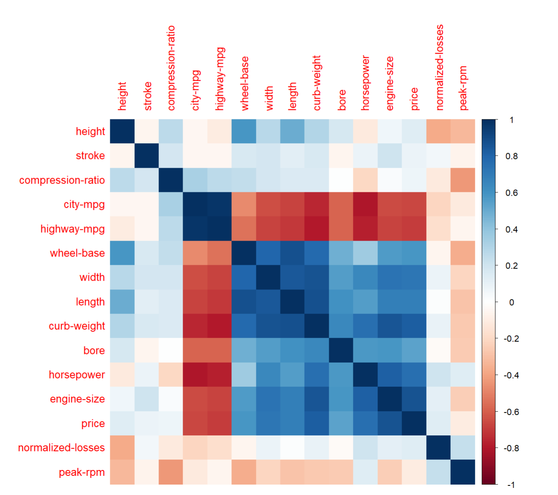
Principal Component Analysis

Slide 25
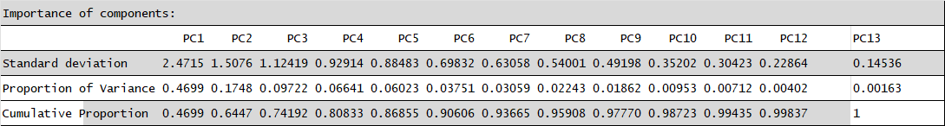
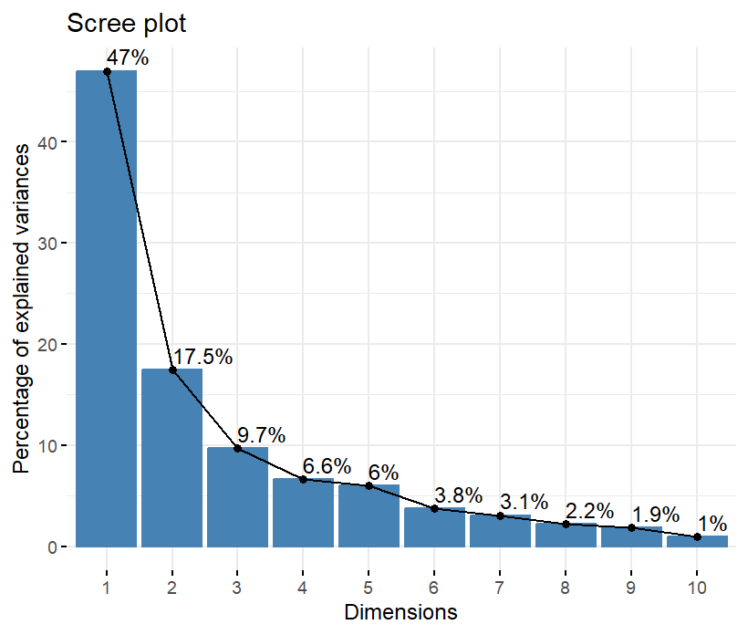
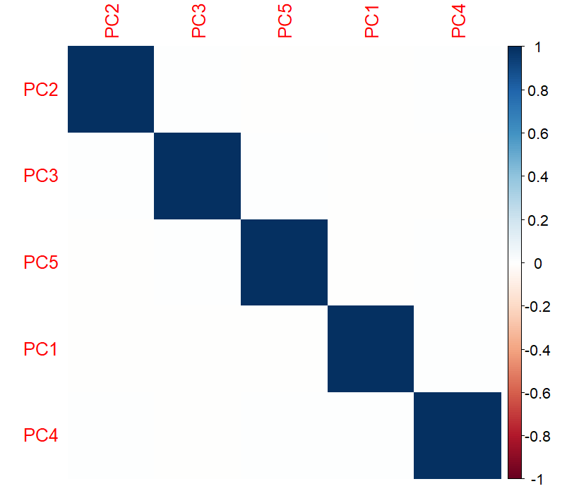
PCA

Slide 26
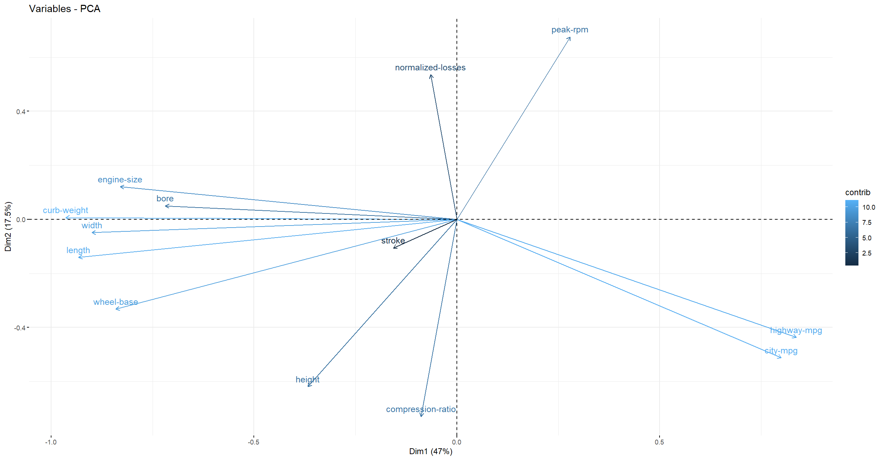
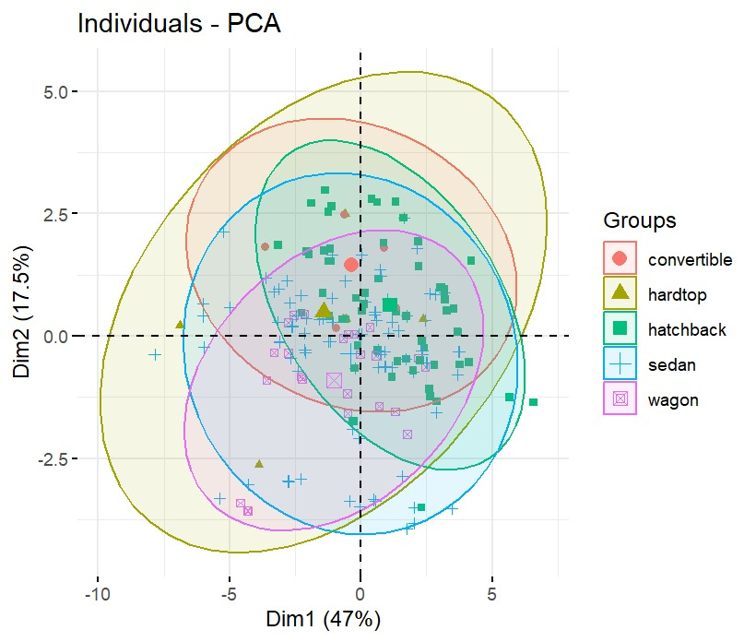
Interpretation of PCA Components

Slide 27
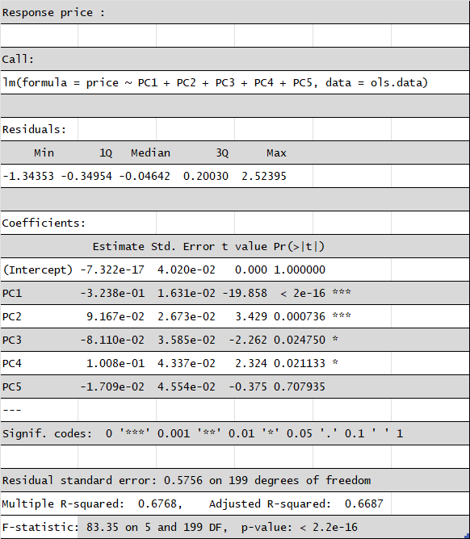
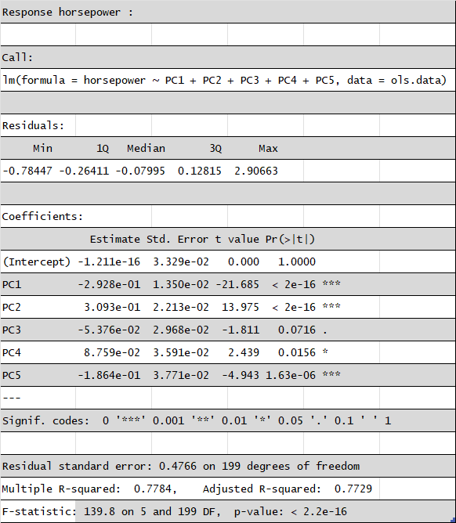
PCA Regression

Slide 28
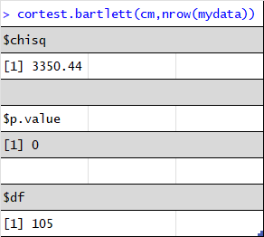
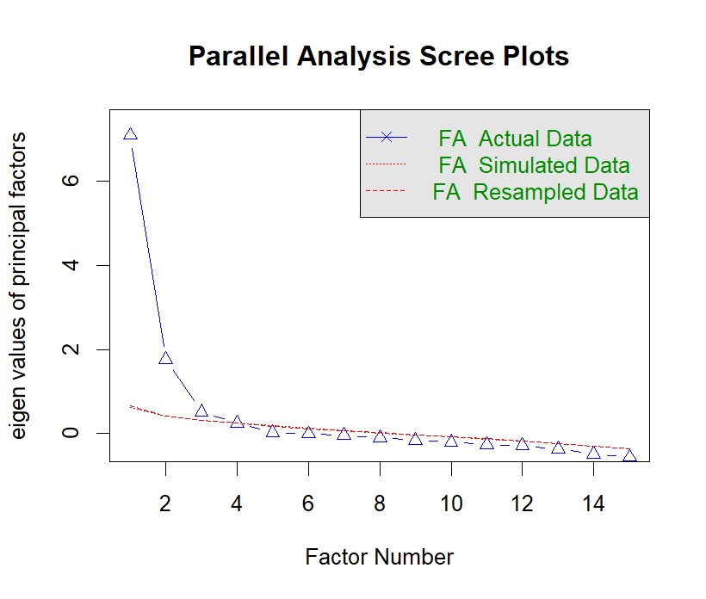
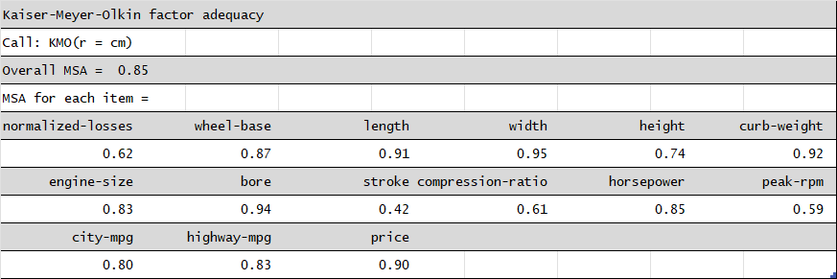
Factor Analysis

Slide 29
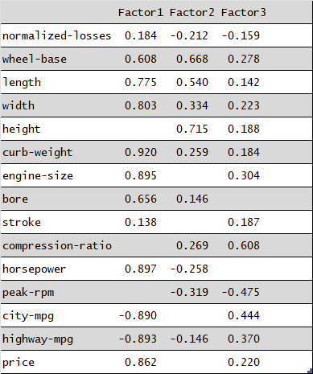
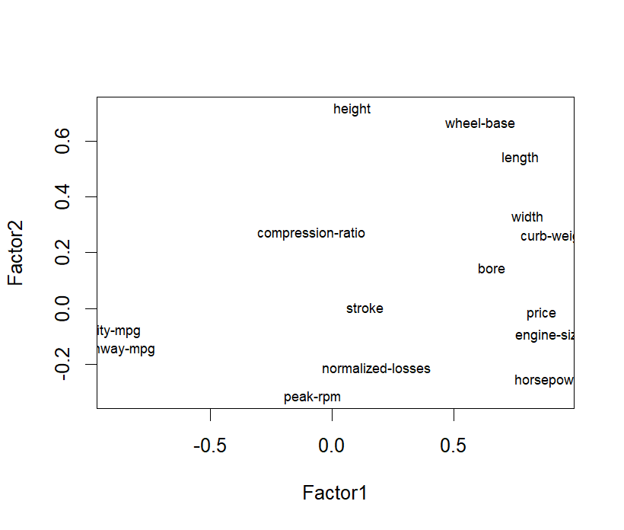
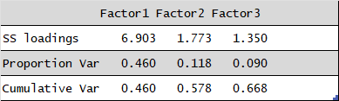
Interpretatıon of factor analysıs

Slide 30
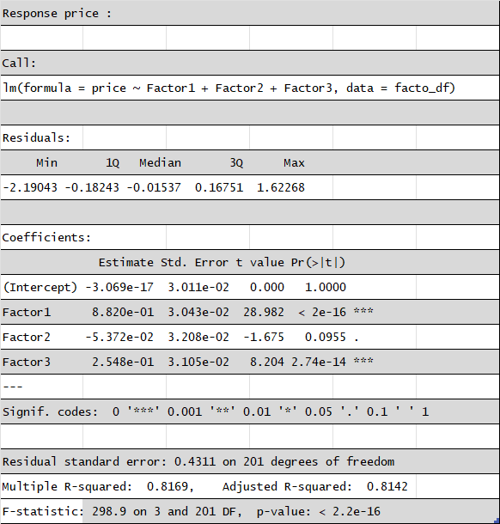
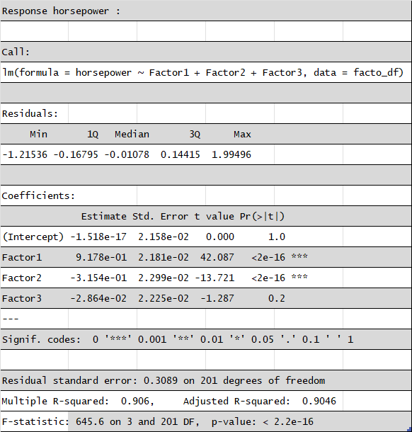
FACTOR ANALYSIS REGRESSION

Slide 31
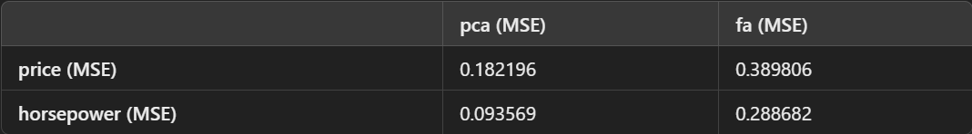
Comparison of PCA and FA Regression

Slide 32
Linear Discrimination Analysis
Is it possible to find a discrimination function based on both categorical and numerical features to accurately classify automobiles as risky or safe?

Slide 33
Summary of the data for LDA
Variables | Description
risk_category | Factor with 2 levels: 'risky' and 'safe'
price_transformed | numeric
horsepower_transformed | numeric
bore_transformed | numeric
highway_transformed | numeric
peakrpm_transformed | numeric
normal_cw | numeric
stroke_transformed | numeric
normal_engine_size | numeric
compression_transformed | numeric
aspiration | Factor with 2 levels: 'std' and 'turbo'
body_style | Factor with 5 levels: 'convertible', 'hatchback', 'sedan', 'wagon', 'others'

Slide 34
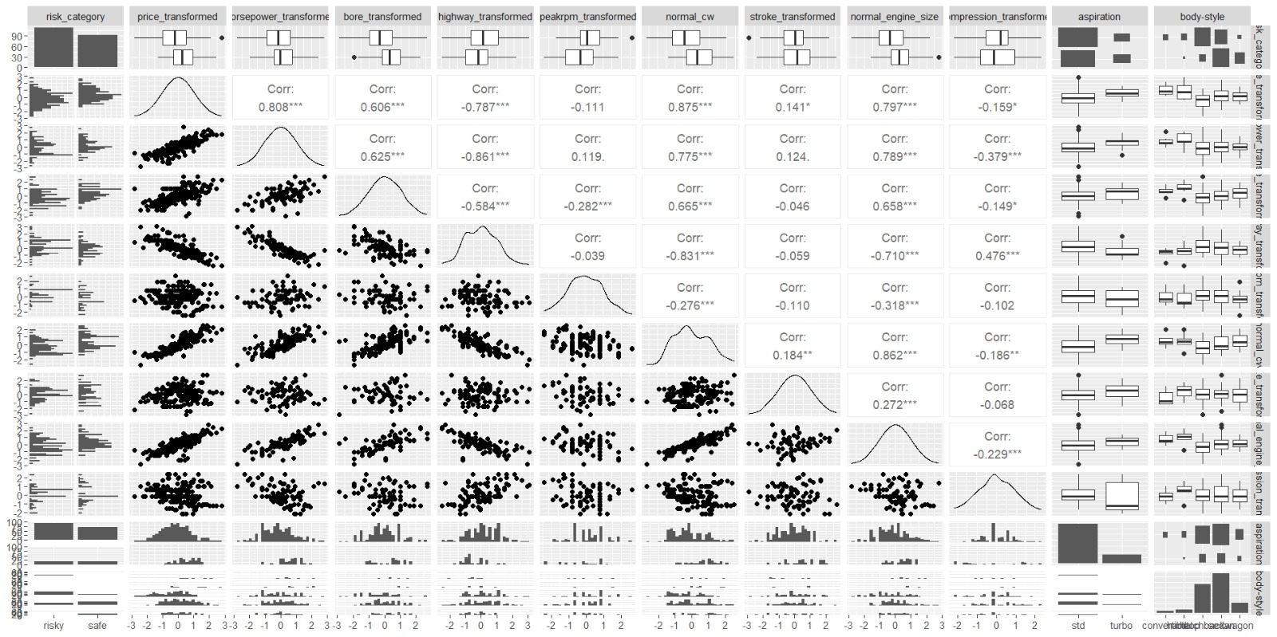
Comparison plot between groups

Slide 35
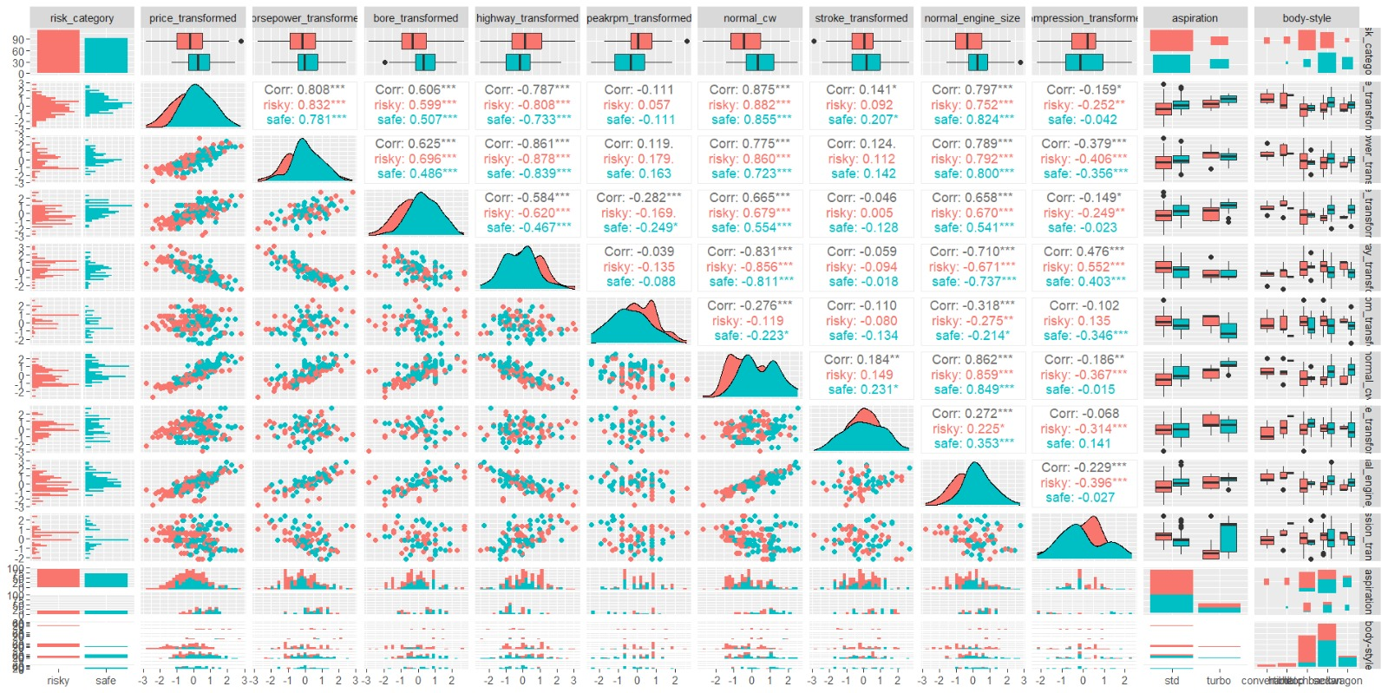
Comparison plot for groups as specified risky and safe

Slide 36
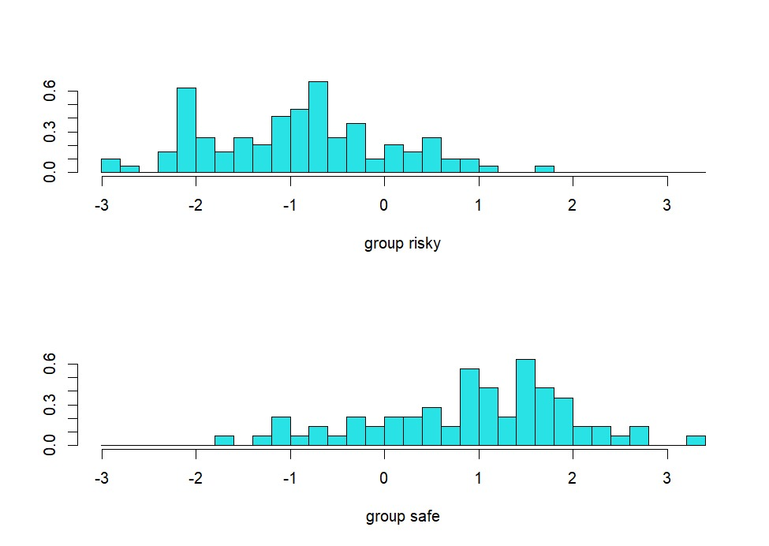
Linear discriminants obtained

Slide 37
Summary for LDA model
Feature | Risky | Safe
price_transformed | -0,2475 | 0,412981
horsepower_transformed | -0,08288 | 0,160474
bore_transformed | -0,24801 | 0,375373
highway_transformed | 0,149041 | -0,24873
peakrpm_transformed | 0,261472 | -0,36847
normal_cw | -0,30801 | 0,510971
stroke_transformed | -0,00049 | 0,015342
normal_engine_size | -0,24135 | 0,385616
compression_transformed | 0,029499 | 0,02945
aspirationturbo | 0,154639 | 0,267606
body_stylehardtop | 0,051546 | 0,014085
body_stylehatchback | 0,546392 | 0,112676
body_stylesedan | 0,340206 | 0,633803
body_stylewagon | 0,020619 | 0,239437
Group | Probability
risky | 0,577381
safe | 0,422619
Prior Probabilities
Group Means

Slide 38
Summary for LDA model
Feature | LD1
price_transformed | 0,225219
horsepower_transformed | -0,27513
bore_transformed | 0,173572
highway_transformed | 0,628383
peakrpm_transformed | -0,15523
normal_cw | 1,082751
stroke_transformed | -0,15742
normal_engine_size | -0,05426
compression_transformed | -0,24144
aspirationturbo | -0,06879
body_stylehardtop | 0,902882
body_stylehatchback | 1,27021
body_stylesedan | 2,517626
body_stylewagon | 3,50927
LD Coefficients

Slide 39
The plot of the model

Slide 40
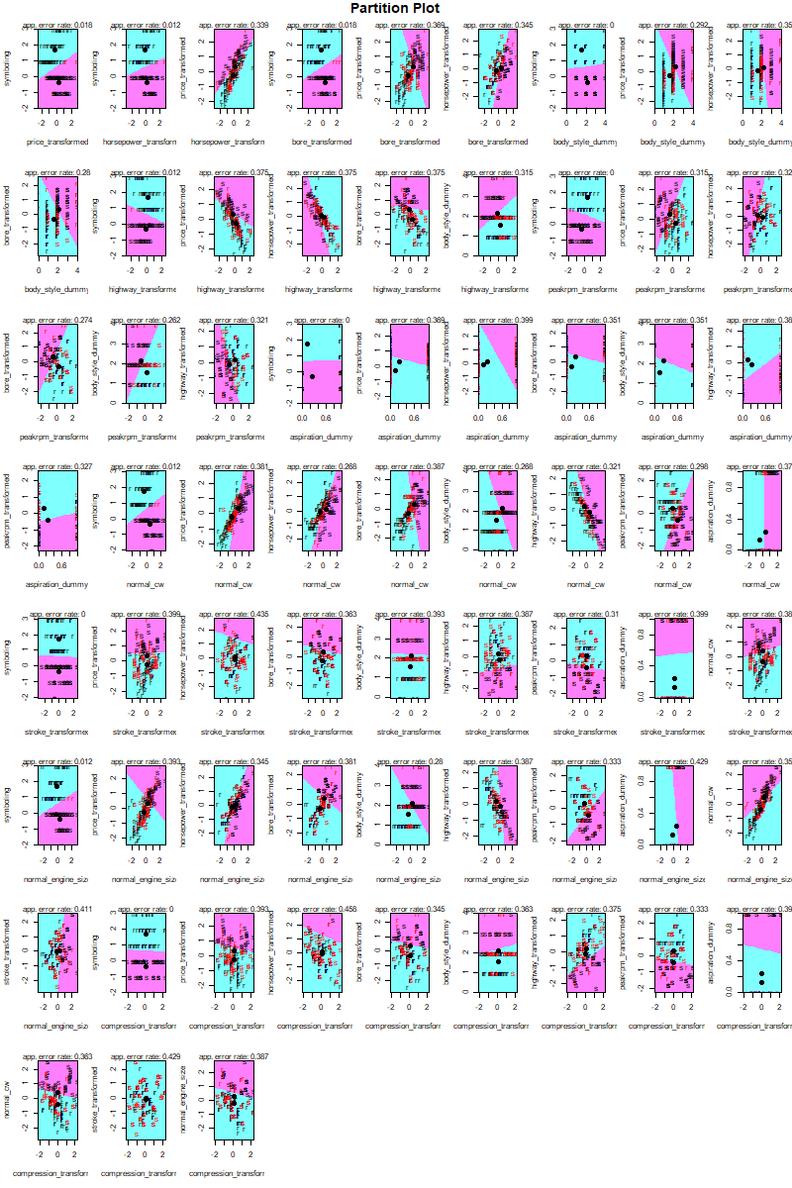
Partition plot for group interactions

Slide 41
Confusion Matrix for the performance
Predicted\Actual | Risky | Safe
Risky | 80 | 16
Safe | 16 | 56
Shows %80.95 success

Slide 42
Confusion Matrix for the accuracy
Predicted\Actual | Risky | Safe
Risky | 15 | 3
Safe | 2 | 17
The model is %86.49 accurate.

Slide 43
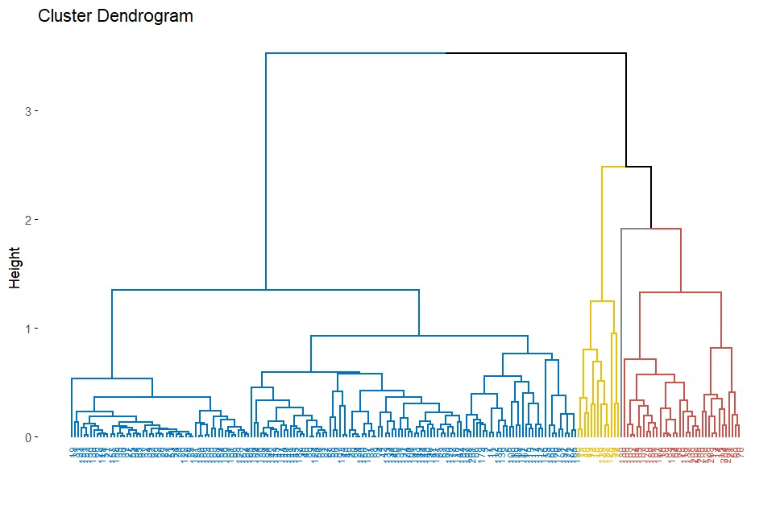
Clustering
What insights can be obtained from clustering automobiles based on numerical features such as curb weight, engine size, price, and horsepower, and how effectively do the resulting clusters correspond to the predefined risk categories (safe vs. risky)?

Slide 44
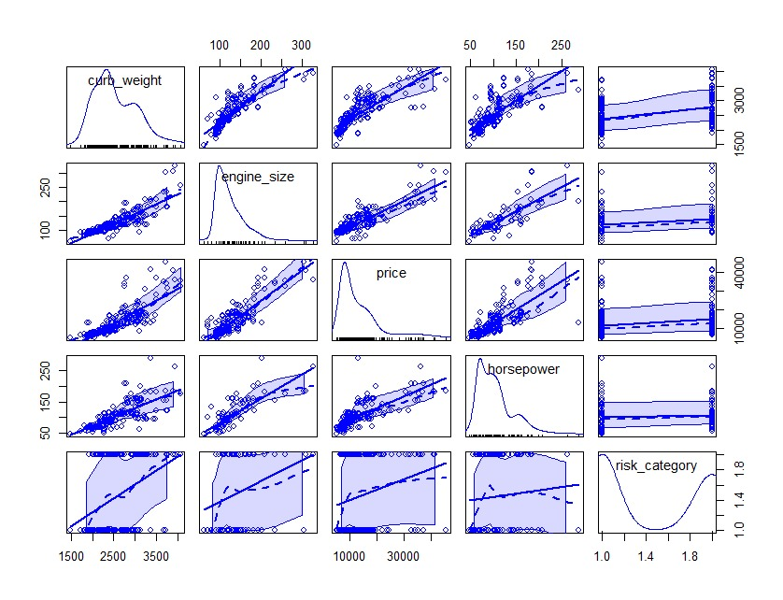
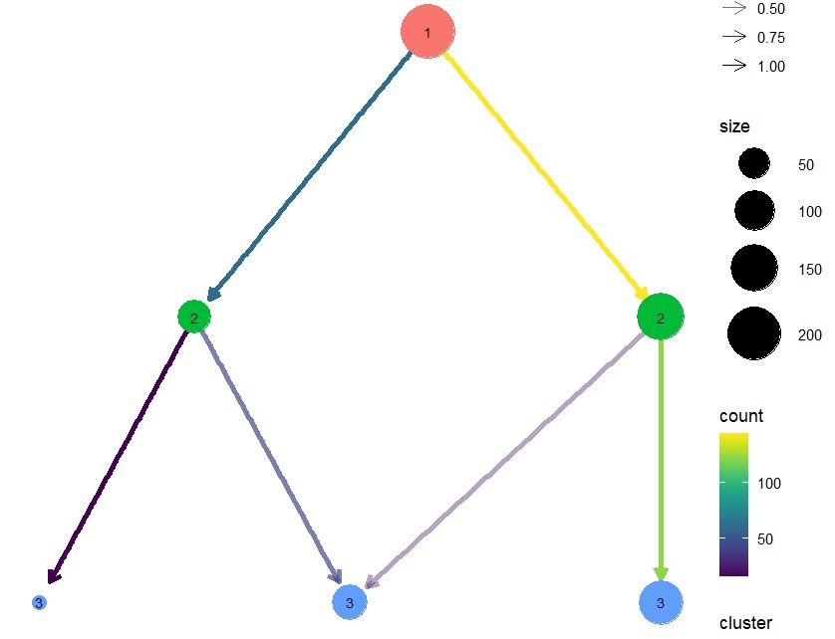

Slide 45
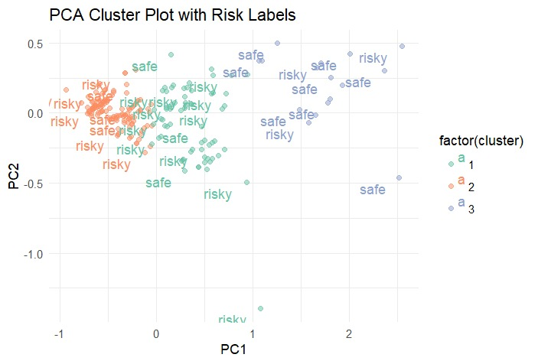

Slide 46
Thank you! Do you have any questions?

